Slide 1
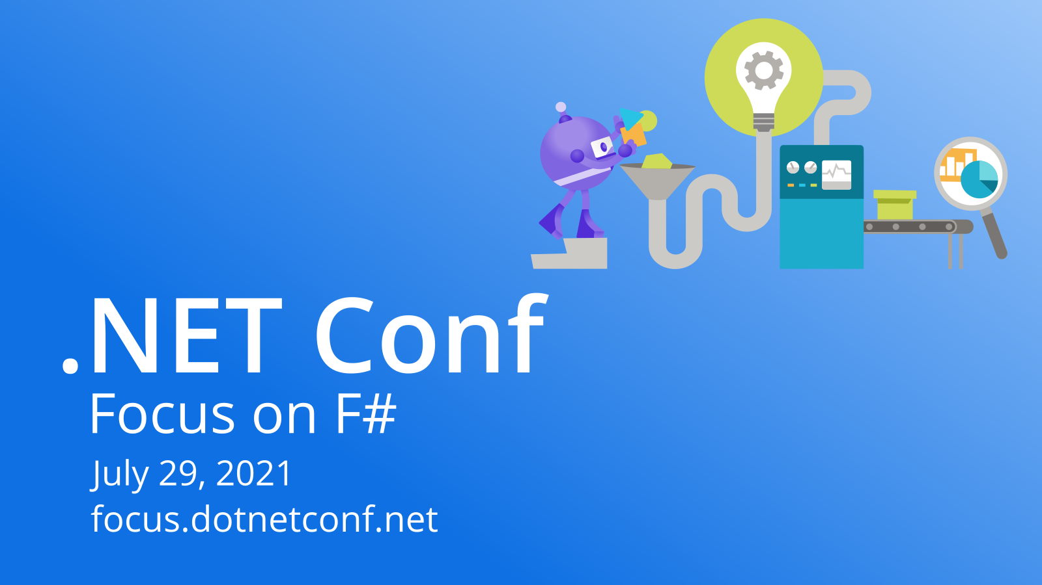

Slide 2

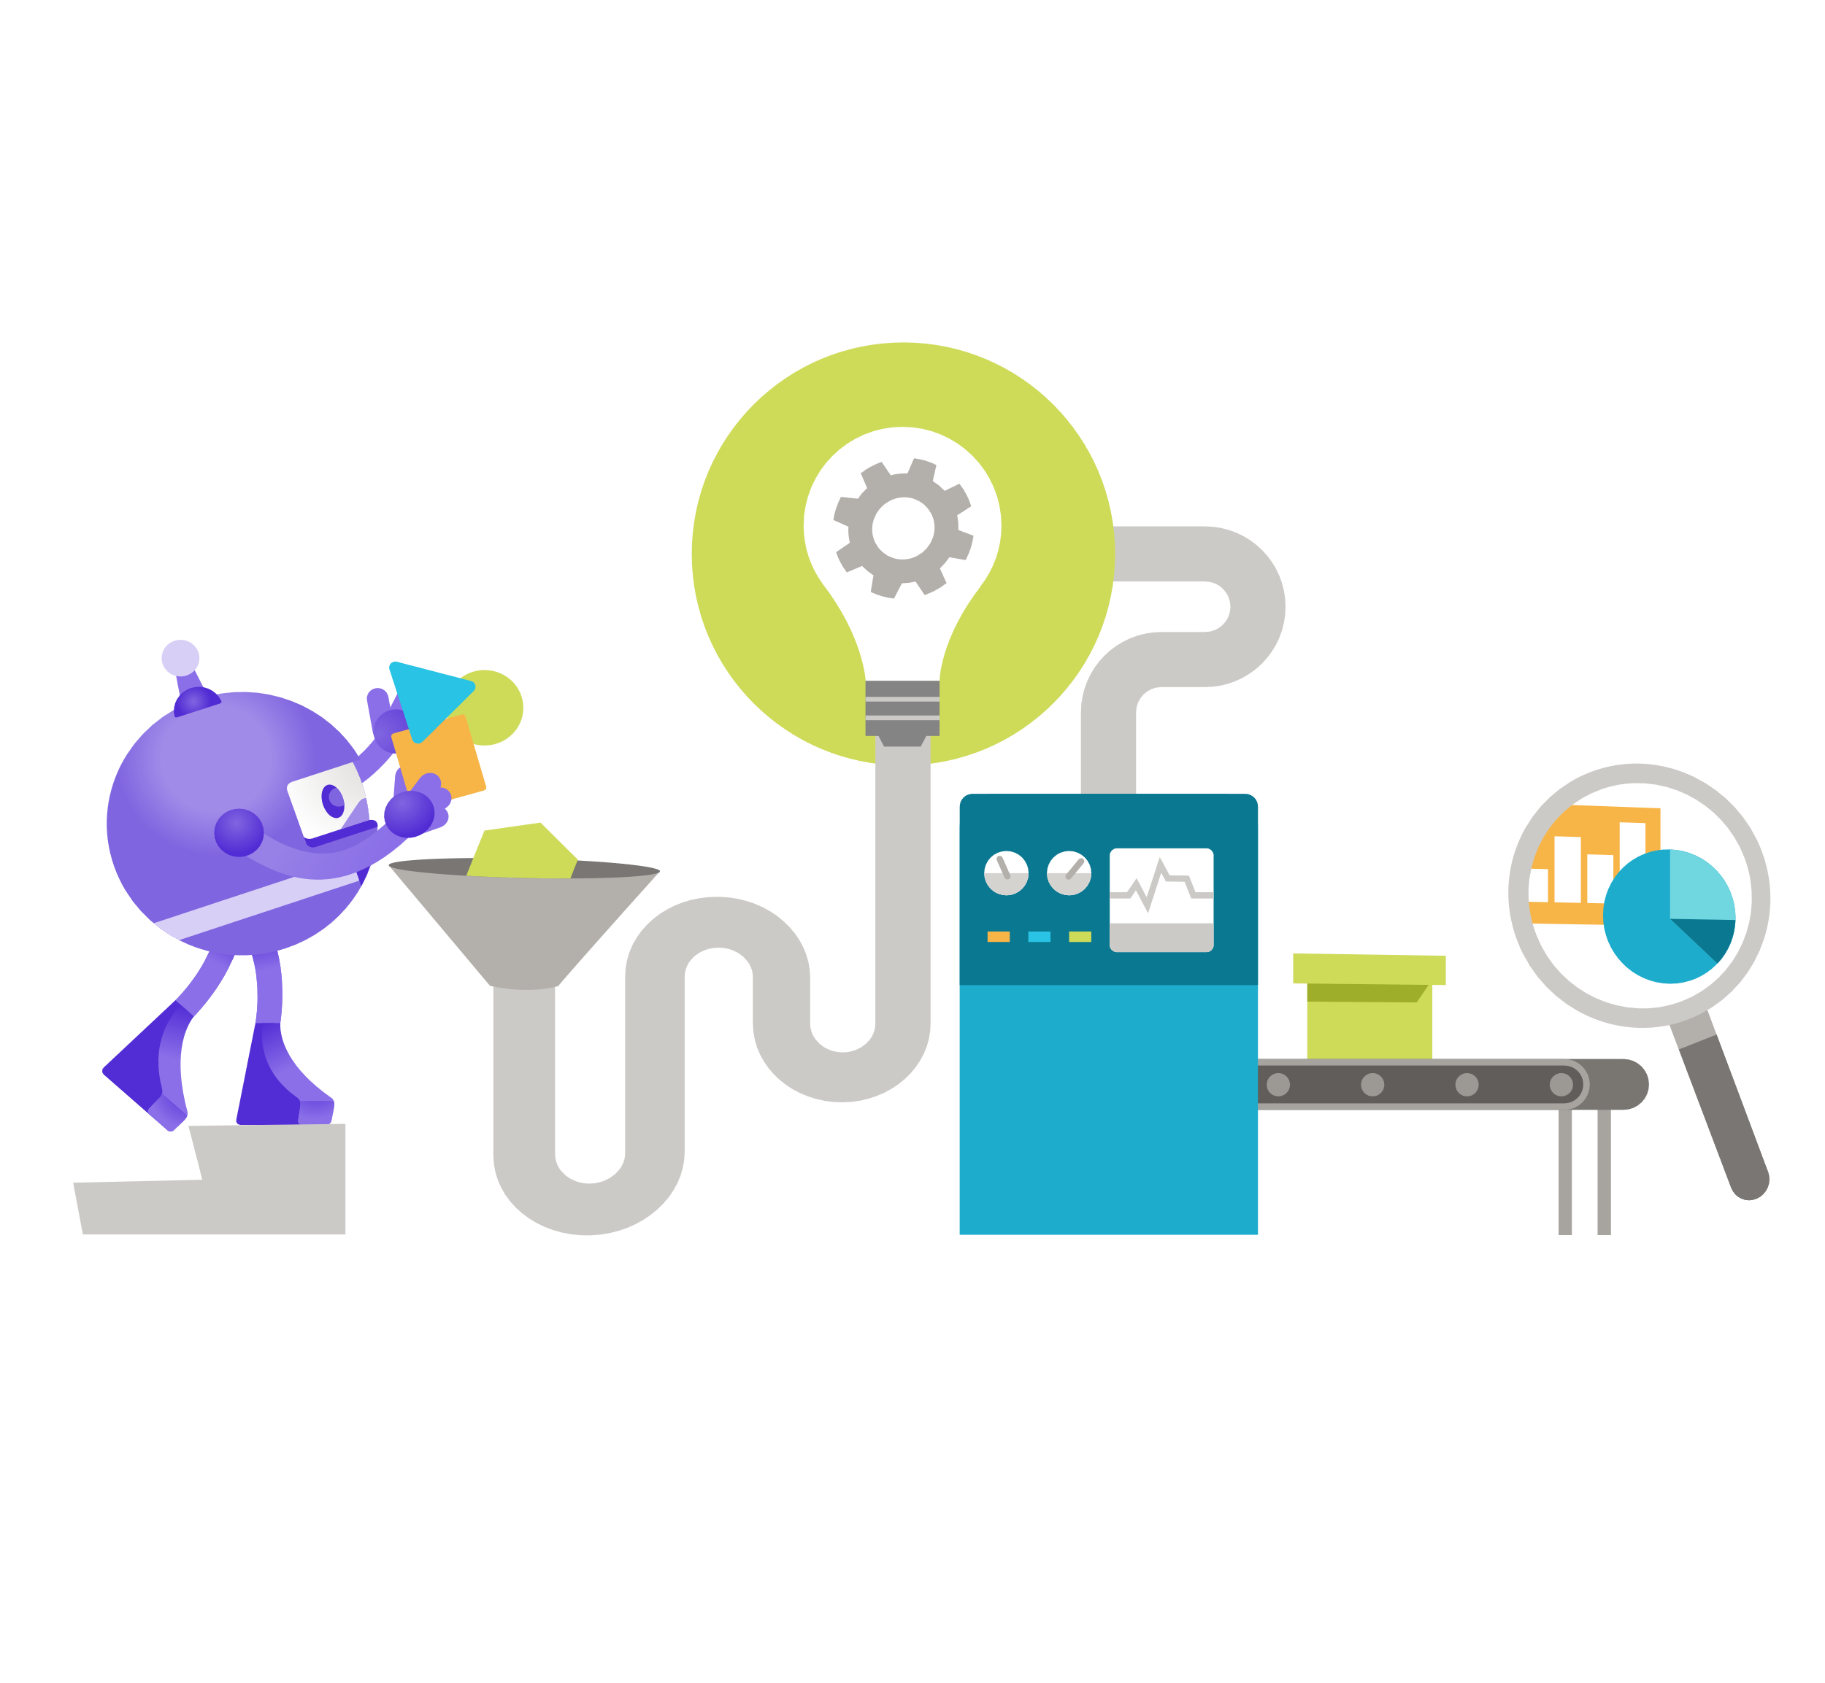
Deploying Cloud Infrastructure with F#
Dave Curylo

Slide 3
About me
Part of Microsoft Atlanta
Engineer on Azure Dedicated team
Expertise in infrastructure and distributed systems development
Member of F# Software Foundation Board of Trustees
Twitter: @i_no_see_pound
GitHub: ninjarobot

Slide 4
What is Infrastructure Development?
Software to deploy and manage physical and virtual hardware so others can build on a solid platform
Says words like
Idempotent
Infrastructure as a service
Goal state
Resources are constrained by money, time, physical space, hardware limits
Infrastructure testing is SLOW
System failure is an expectation

Slide 5

Running applications on a cloud
Cloud native applications are built with dependencies on cloud infrastructure.
Benefits of scale – a tiny company can use the same resources and processes as huge enterprises.
Instead of a local library, you may use a functionality from a remote system.
Be cognizant of failure modes

Slide 6
Failure Modes and Optimism
Most code is written optimistically. Fail fast, log errors, recover, move on.
Failure modes can cascade
A failure (authentication, DNS, etc) causes a call to one component to fail, leading to another failure, and another.
These are distributed systems, rollback and retry are questionable.
Representing failure in the type system brings benefits
The compiler keeps you honest about failure modes.
Cascading failures are not pointed out by subjective engineers, but by an objective compiler.

Slide 7
Errors vs. Exceptions
Errors
Represented in the signature of a call.
Compiler checks that you handle these cases.
Developers are forced to proactively consider failure modes.
Exceptions
Not represented in the signature.
Person who knows internals must check that code handles them.
Found during testing or deployment – reactively.

Slide 8
Orchestration and Failure
Orchestration of multiple service calls to reach a goal state.
Any of these service calls may fail for unexpected reasons.
Handling errors internally means we can represent a terminal state vs. transient failures.
Transient failures are solved by retries – keep asserting the goal state until we get a terminal state (success or failure).

Slide 9
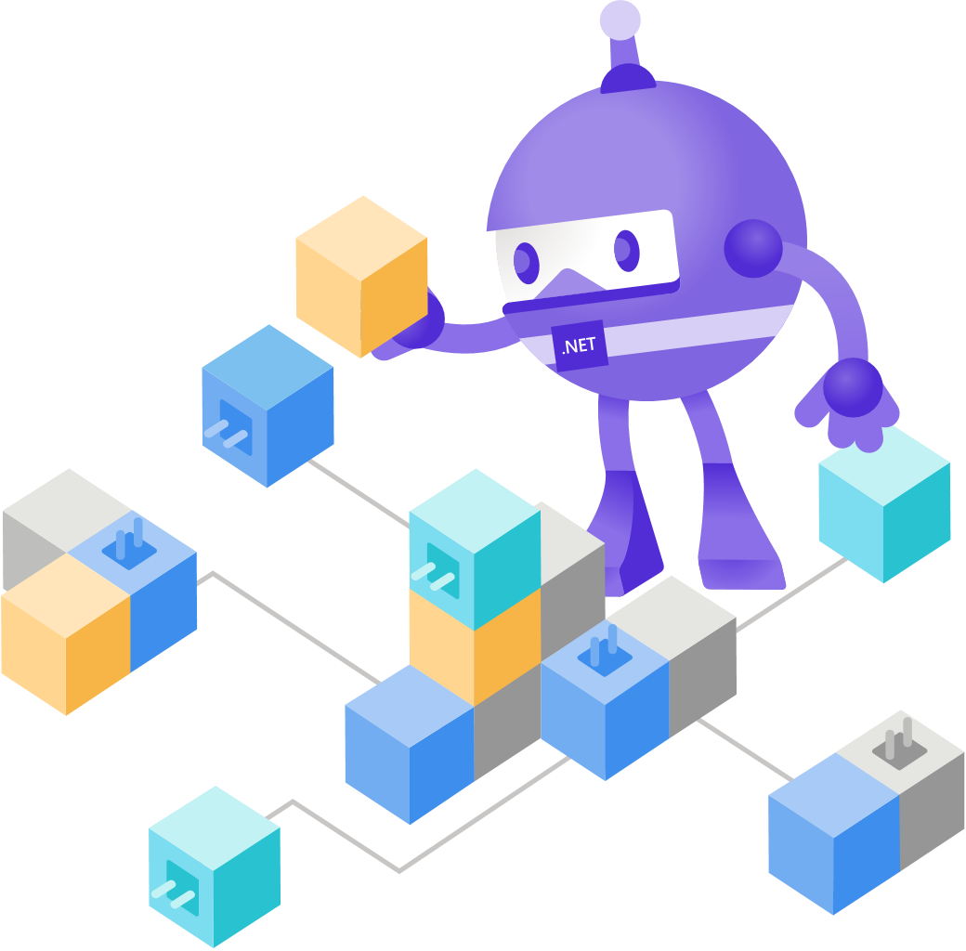
ARM Deployments
Orchestrate a series of goal states
Retry automatically until reaching a terminal state
Execute in the cloud
Integrated with Azure authentication, auditing, and telemetry
Orchestration you don’t have to write or execute.

Slide 10
Challenges of ARM Deployments
Syntax is very verbose – JSON or Bicep.
Dependencies are manually managed in the template.
Composition is very limited.
Just goal states, any logic must be done externally.
No ecosystem available – just a handful of expressions.
This can lead to a lot of templates and a lot of parameters to manage. It’s an external file, so no type checking here.

Slide 11
Farmer – Type-safe ARM Orchestration
Generates standard ARM templates.
Authored as F# code – giving full type checking.
Builders for each type of resource are composed.
A builder can add one or more resources to the template.
Automatically generates dependencies to allow ARM to orchestrate the deployment effectively.
F# is cross platform – use it anywhere.

Slide 12
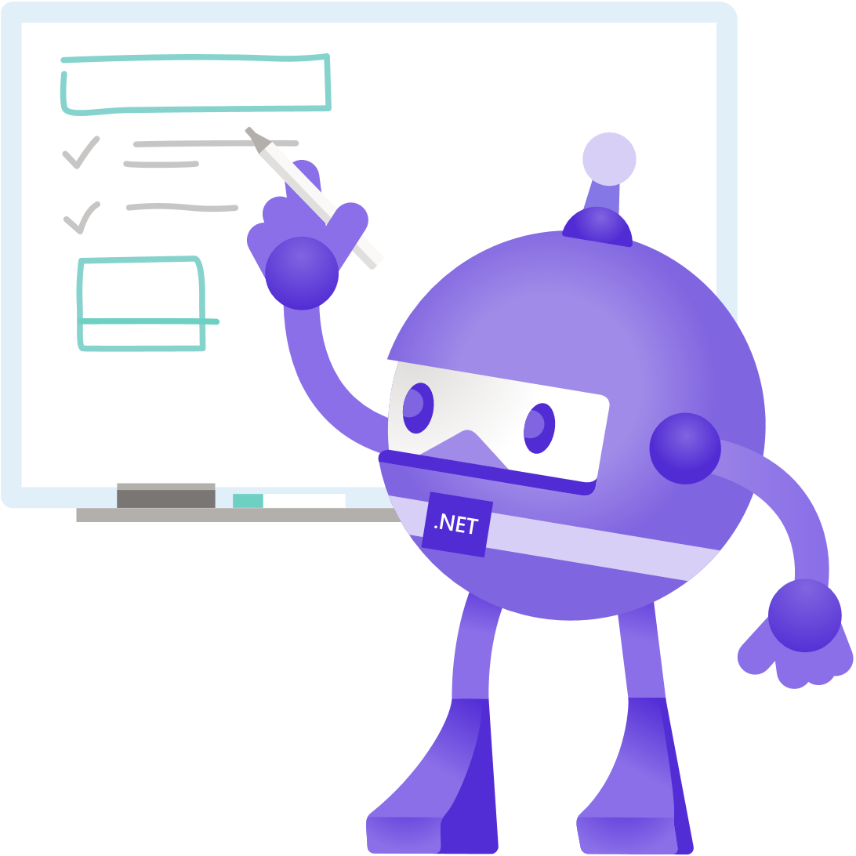
Code Sample
containerGroup {
name "farmercontainers"
public_dns "farmercontainer" [TCP, 80us]
add_instances [
containerInstance {
name "xplot-service"
image $"{myAcr.Name.Value}.azurecr.io/fsharpwebapp:{imageTag}"
add_public_ports [ 80us ]
}
]
reference_registry_credentials [
Arm.ContainerRegistry.registries.resourceId myAcr.Name
]
depends_on buildImage
}

Slide 13
Community
“Contributing is what the F# community does best.”
--Eugene Tolmachev
F# is built on community engagement – long time OSS model
A lot of influence comes from other ecosystems – Javascript, Haskell, Scala, Python.
The strong influence of composition allows developers to choose the best components and libraries.
Composition + engagement = thriving community

Slide 14
Participating in the F# OSS Community
Farmer was started by Isaac Abraham of Compositional IT.
Azure engineers use and contribute to Farmer.
Like many community-driven projects, its high quality, well tested and documented, and keeps a low bar to contributing.
Opportunity to build within the community.
Farmer is used in SAFE Stack templates.

Slide 15
Demo – F# to the Cloud
Dave Curylo
Samples at https://github.com/ninjarobot/dotnetConf2021

Slide 16
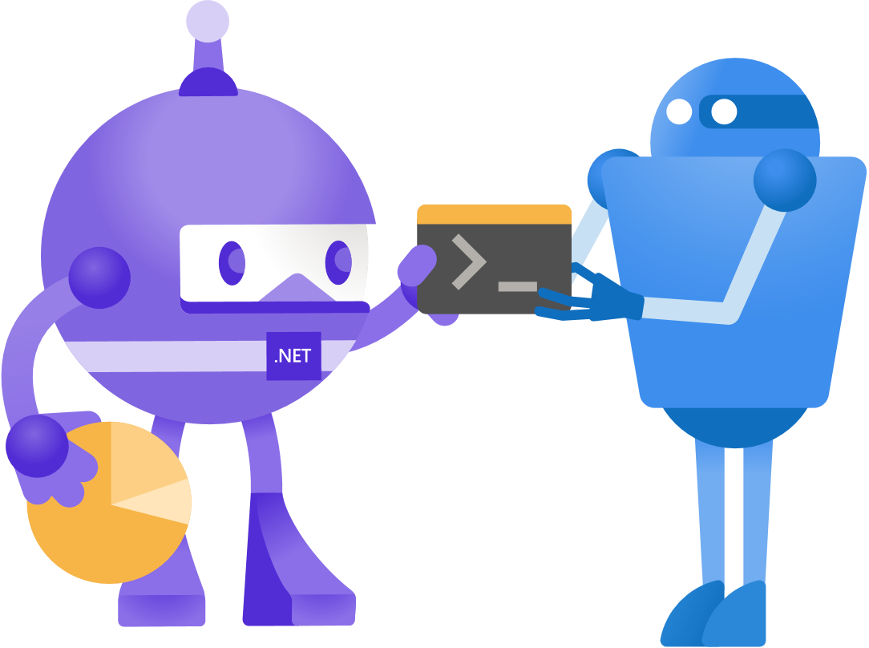
Demo – Let’s use F# for Infrastructure
F# is for math and science, so make something mathy.
Make it into a service.
Define a Dockerfile for that service.
Build a container registry.
Send the Dockerfile to the registry to build it.
Deploy the image to a container group.
Farmer helps us manage the scale and complexity at compile time.

Slide 17
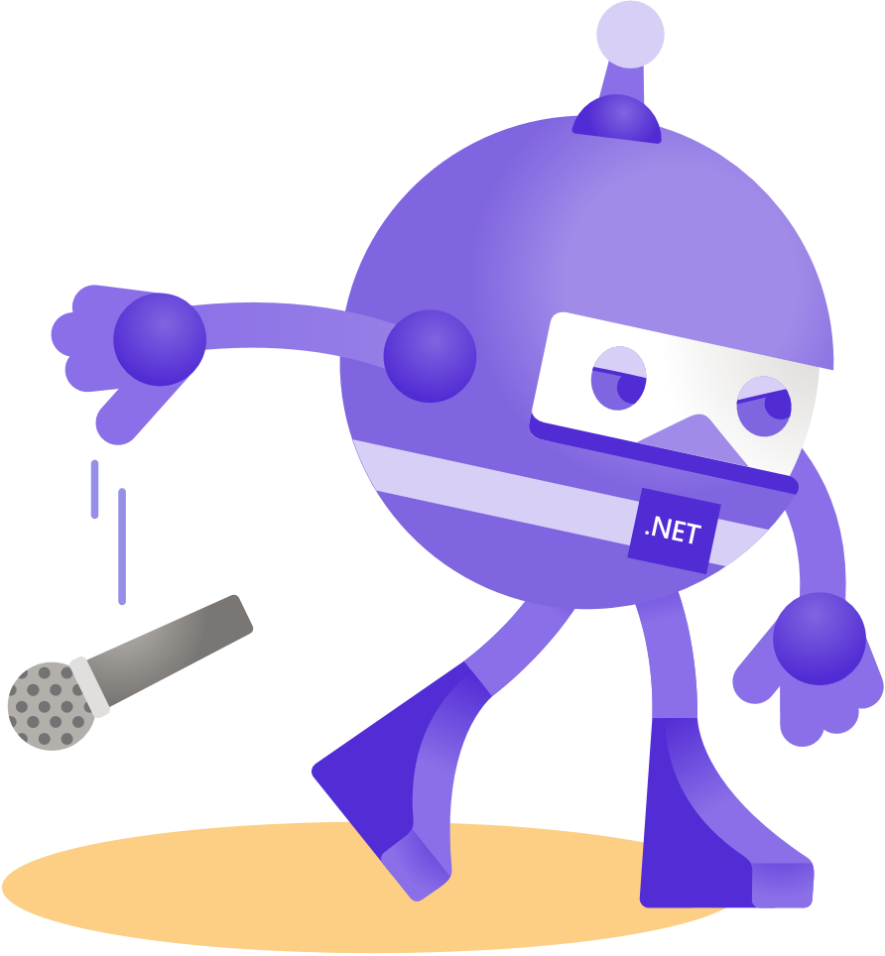
Thanks for joining!
Ask your questions live on Twitter #dotNETConf

